Slide 1
Installing and running the local check and grader projects in Eclipse

Slide 2
Setup projects

Slide 3
Download projects from Github
Quick overview, in depth follows
File->Import…
Git->Projects from git
Clone URI
  https://github.com/pdewan/Comp401LocalChecks.git
  https://github.com/pdewan/GraderBasics.git
  https://github.com/pdewan/Comp401AllChecks.git
  https://github.com/pdewan/Grader.git
  https://github.com/mdaum/PlaigarismCoupler.git
  https://github.com/mdaum/PlayingwPlaggie.git
Grader branch = integration
Rest = master

Slide 4
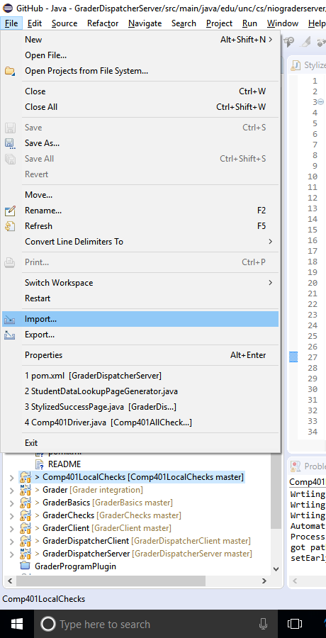
Download projects from Github
Import project

Slide 5
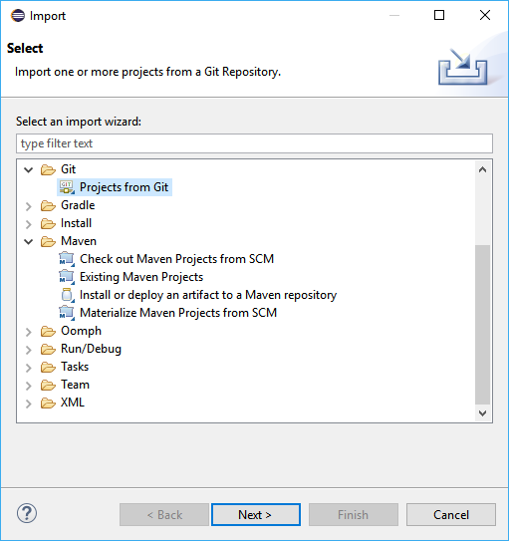
Download projects from Github
Select “Projects from Git”

Slide 6
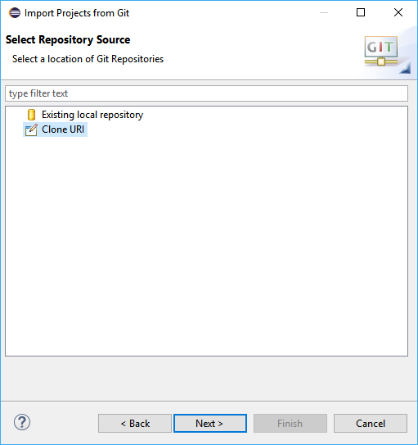
Download projects from Github
Clone URI
Comp401LocalChecks
  https://github.com/pdewan/Comp401LocalChecks.git
GraderBasics
  https://github.com/pdewan/GraderBasics.git
Comp401AllChecks
  https://github.com/pdewan/Comp401AllChecks.git
Grader
  https://github.com/pdewan/Grader.git
PlagirismCoupler
  https://github.com/mdaum/PlaigarismCoupler.git
PlayingwPlaggie
  https://github.com/mdaum/PlayingwPlaggie.git

Slide 7
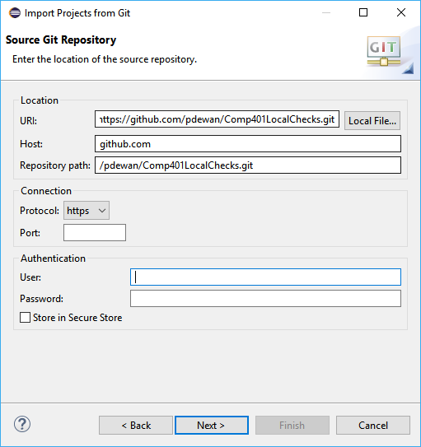
Download projects from Github
Set the URI for the project from GitHub
Eclipse autocompletes the rest

Slide 8
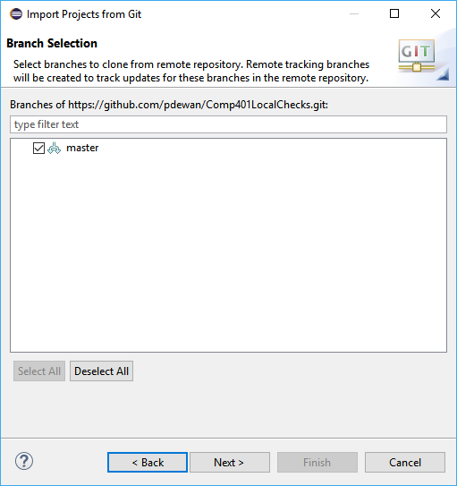
Download projects from Github
Choose the “master” branch for all but grader
Grader is “integration” branch

Slide 9
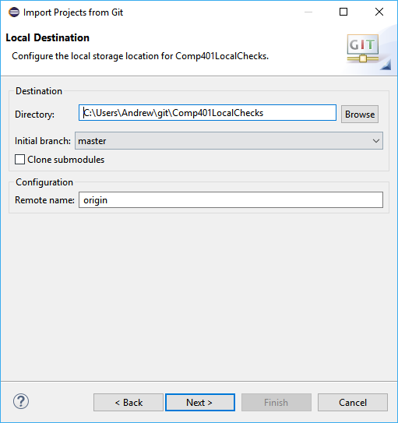
Download projects from Github
Choose a directory to save the git project

Slide 10
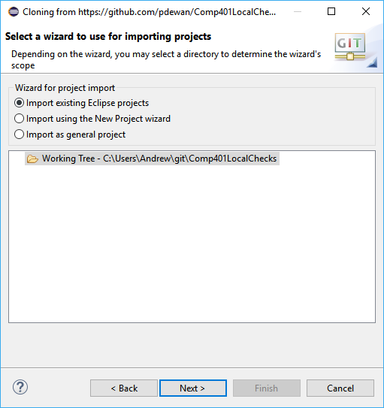
Download projects from Github
All projects are existing Eclipse projects

Slide 11
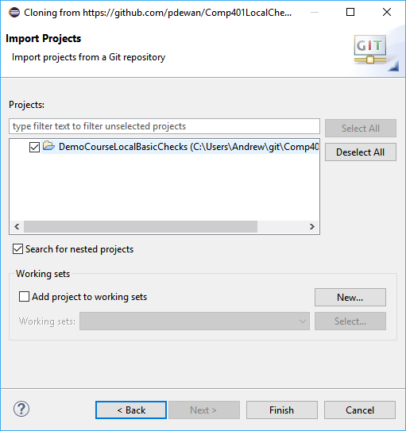
Download projects from Github
There may be other projects in the git repository, only import the relevant ones (not Assignments)

Slide 12
Correct dependencies
Projects
  DemoCourseLocalBasicsChecks = Comp401LocalChecks
  comp110-grader = Grader
Libraries
  oeall22.jar from course website

Slide 13
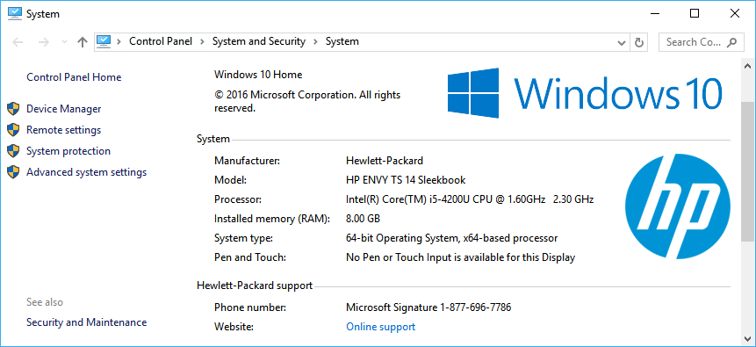
Setup Checkstyle/UNC Checks (Windows)
Open “System” from “System and Security” in the Control Panel
Select “Advanced system settings”

Slide 14
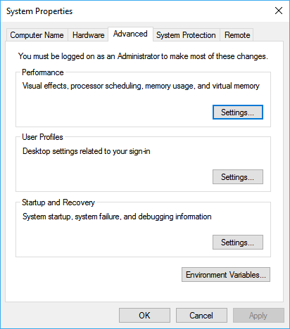
Setup Checkstyle/UNC Checks (Windows)
Select Environment Variables…

Slide 15
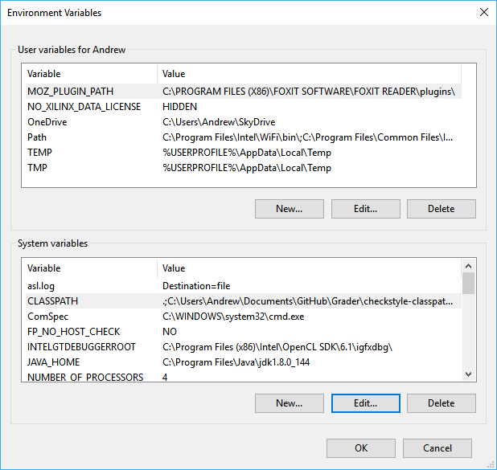
Setup Checkstyle/UNC Checks (Windows)
Create a new environment variable called “CLASSPATH” and set it to contain 3 paths separated by semicolons
  .
  Path to checkstyle-6.5.0-all.jar
  Path to UNC_Checks6.5.0.jar
.;C:\Users\Andrew\Documents\GitHub\Grader\checkstyle-classpath\checkstyle-6.5-all.jar;C:\Users\Andrew\Documents\GitHub\Grader\checkstyle-classpath\UNCChecks_6.5.0.jar
Changes effective in all applications opened after added

Slide 16
Setup Checkstyle/UNC Checks (Mac)
Need to add to ~/.bash_profile
  Use export X=Y to assign the environment variable X to value Y
  export CLASSPATH=$CLASSPATH:.:/path/to/checkstyle-6.5.0-all.jar:/path/to/UNC_Checks6.5.0.jar
Need to restart after adding for changes to take effect

Slide 17
Setup Object Editor
Install maven
Open a terminal window in a directory containing the latest version of Object Editor (oeall-22)
Install the oeall-22.jar file to the local maven repository
  mvn install:install-file -Dfile=oeall-22.jar -DgroupId=edu.unc -DartifactId=oeall -Dversion=22 -Dpackaging=jar

Slide 18
Run local checks

Slide 19
Setup assignment for local checks
Open assignment with eclipse
Add local checks dependencies
  Projects
    Comp401LocalChecks
    GraderBasics
Add new main class to call local check suite

Slide 20
Sample test class
package main;
import gradingTools.comp401f17.assignment1.testcases.Assignment1Suite;
public class A1LocalChecks {
public static void main(String[] args) {
Assignment1Suite.main(args);
}
}

Slide 21
Run local checks
Select test main class
Right click → Debug As → 1 Java Application
AGradeableJUnitTopLevelSuite → Test All

Slide 22
Running the grader

Slide 23
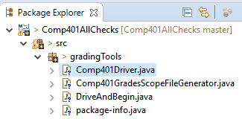
What to run
gradingTools.Comp401Grader from Comp401AllChecks

Slide 24
Submissions directory structure
Should use data straight from Sakai
Check Comp401AllChecks\Test Data\Comp401F17\Assignment1 for example

Slide 25
First run
There will be a message about missing download path, this is okay
Grader saves paths, course/assignment choices, and onyens in config files when run

Slide 26
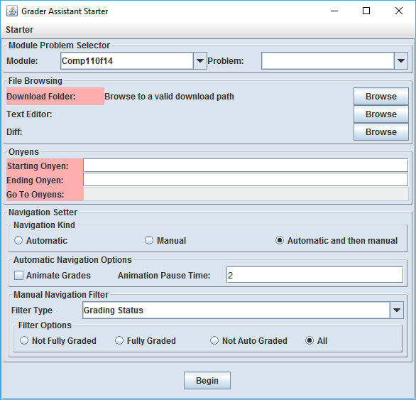
Setting what to grade
Set Download folder to folder containing assignments
Set Module to correct course
Set Problem to assignment to grade

Slide 27
Setting who to grade
Range of onyens
  First/last in starting/ending onyen boxes
List of onyens
  Comma separated list I go to box.

Slide 28
Setting how to grade
Navigation Kind
  Automatic
    Auto grade all students then exits
  Manual
    No auto grading, just opens grading review view
  Automatic and then manual
    Runs all auto grading then opens the review view

Slide 29
Setting what to see
Automatic Navigation Options
  Animate grades
    Shows the review for each student view during auto grading
  Animation pause time
    Time before displaying next student after finishing previous

Slide 30
Setting what to see cont.
Manual Navigation Filter
  Grading Status
    How graded is the submission?
  Note Status
    How much has the grade been explained
  Letter Grade
    What grade was recieved

Slide 31
Grading
Run gradingTools.Comp401Driver from Comp401AllChecks
Select Comp401f18 in the “Module” dropdown
Set “Download Folder” to assignment directory
Select the correct assignment in the “Problem” dropdown
Enter first and last onyen to grade
Set “Navigation Kind” to “Automatic and then manual”
Select “Begin”

Slide 32
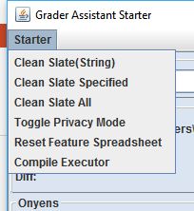
Note: clean slate to regrade onyens
Previously graded assignments will not be auto graded again
Clear old grading with clean slate under “Starter”
  Clean Slate(String)
    Enter onyen to be cleared
  Clean Slate Specified
    Clears based on onyen range in UI
  Clean Slate All
    Clears all students

Slide 33
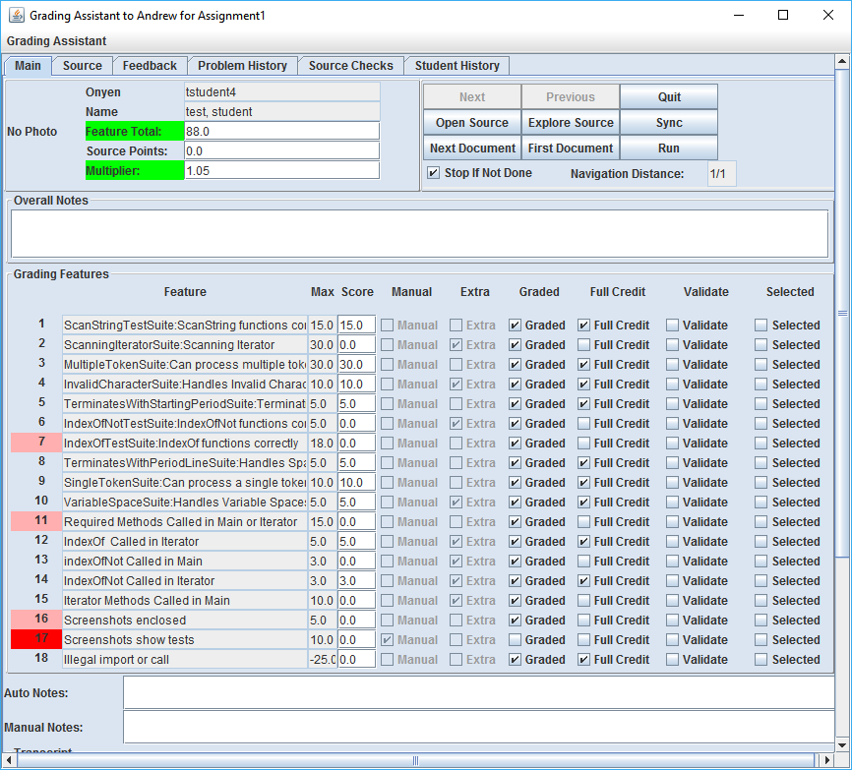
Result UI Overview

Slide 34
Tabs
Main
  Grading results
Source
  Submitted source code
Feedback
  Textual representation of grading results
Problem History
  Grading results of other students
Source Checks
  Checkstyle output
Student History
  Previous results for current student

Slide 35
Main tab overview

Slide 36
Upper Left—Student Overview
Onyen
Name
Score
Early/late submission score multiplier

Slide 37
Upper Right—Navigation
Next/Previous
  Move to next/previous student’s grading
Quit
  Close grader (all grading saved)
Open Source/Explore Source
  Open submitted source files in text editor
Sync
  Save changed to text fields and submitted source files.

Slide 38
Upper Right—Navigation cont.
Next Document
  Open next submitted document (pictures, text files, etc.)
First Document
  Resets “Next Document” queue to first document
Run
  Runs the submitted program allowing interaction
Stop If Not Done
  Prevents closing the grader if grading is incomplete on any student
Navigation Distance
  Current and total assignments graded

Slide 39
Middle—Grading results
Feature
  Name of test
Max/Score
  Maximum and actual points awarded
  Score can be manually changed
Manual
  If must be manually graded
Extra
  Is extra credit?
Graded
  Has been graded?

Slide 40
Middle—Grading results cont.
Full Credit
  Auto graded as full points
  Sets feature to full credit
Validate
  Marks low scoring feature as being verified as graded properly
Selected
  Display output of feature in “Auto Notes”
Auto/Manual Notes
  Comments on auto/manual grading
Transcript
  Raw output of grading program

Slide 41
Notes for developers

Slide 42
Config files—dynamicmodules.properties
config/dynamicmodules.properties
Automatically generated by grader
List of modules for grader

Slide 43
Config files—dynamicconfig.properties
config/dynamicconfig.properties
Automatically generated by grader
Saves values of fields in UI
  Directories
  Course
  Assignments
  Onyens
  Etc.

Slide 44
Config files—.gradersettings
.gradersettings
Automatically generated by grader
Small subset of data from dynamicconfig.properties

Slide 45
Config files—config.properties
config/config.properties
In depth grader runtime controls

Slide 46
Config files—course.properties
config/course.properties
List of courses to display
Settings per course
Checkstyle config file asssociations

Slide 47
Config files—user-config.properties
config/user-config.properties
When running in headless mode the configuration is changed based on command line arguments, the grader makes a copy of the config.properties file with any relevant changes and saves it as this so the default values aren’t changed in config.properties

